Slide 1
MYNTRA · GROWTH · WISHLIST-TO-PURCHASE CONVERSION
Wishlist saves rarely become purchases — here's the metric, and how we broke it down
Business metric: % of users who purchase at least one wishlisted item within 30 days of adding it.
Intent
→
Availability
→
Re-encounter
→
Resolution
→
Checkout
+ Price-Certainty — a soft hesitation factor that modulates Resolution, not a hard sequential gate like Availability
The no-money constraint (no discounts, no incentives) rules out most price levers directly — pushing the real addressable opportunity toward Intent, Re-encounter, and Resolution. That narrowing is derived from this decomposition, not assumed going in.
What follows: AI discovery → primary research → one defined problem → a working MVP, measured against real success metrics.
Wishlist → Purchase Conversion | NL Myntra
1

Slide 2
The AI discovery engine — architecture and what it found
1
→
2
→
3
→
4
→
5
→
6
Scrape
Clean
Pre-filter
(noise cut)
Gold Set
n=137
Coding Agent
(Groq)
Findings
Step 3 ("pre-filter") is a small, cheap relevance-only pass that screens 2,203 raw reviews down to what's actually pre-purchase-hesitation signal, before the fuller 9-category classifier ever runs on it — separating real signal from app-review noise (delivery complaints, generic praise) early and cheaply.
2,203 classified · n=137 gold set · 89.4% agreement
0.875 accuracy vs. human labels
κ=0.159 cross-model agreement — a weaker local model, not a codebook problem
Four categories never appeared in reviews at all — not rare, just the wrong instrument. Primary research picks up where the corpus stops.
Wishlist → Purchase Conversion | NL Myntra
2

Slide 3
Try the discovery engine yourself — two live ways in
1 · DIRECT API CALL
2 · INTERACTIVE DEMO (STREAMLIT)
POST any short review/comment text; get back is_relevant, primary_barrier, confidence, and 2 optional fields — a real classification call, not a demo stub.
A page over the same live webhook, with three panels: real corpus stats, real interview quote cards, and the metric framework — no chatbot, no fabricated numbers.
curl -X POST \
$WEBHOOK_URL \
-d '{"text":"waiting for
the price to drop"}'
• Corpus at a glance — 2,203 classified, n=137 gold set, 0.875 accuracy
• 6 real interview quotes with sourced "what this means" notes
• Paste your own text and classify it live, or try a gold-set example
WEBHOOK …/wishlist-discovery-engine
Adds two categories beyond the original 7 — social_validation and comparison_shopping (v3, docs/codebook.md) — closing a real gap against the brief's own question list. Neither has corpus data yet; reported honestly, not silently implied.
LIVE DEMO nl-myntra-graduation-project…streamlit.app
Wishlist → Purchase Conversion | NL Myntra
3

Slide 4
Primary research confirmed what reviews structurally couldn't show
SURVEY — n = 32
INTERVIEWS — 6 people, 2 waves
• 94% (30/32) research outside the app before deciding
“If it was 1,200 I probably would've bought it then and there.”
• 100% (32/32) have had a saved item go out of stock
— P1, on a saved pair of jeans, waiting for a specific price
• Price uncertainty is the #1 reason not bought (9/32)
Every corpus-sparse category (fit, price, occasion, timing) was independently confirmed real here. 6/6 raised availability decay unprompted — the single most unanimous finding in the project.
• 19/32 "trust but would double-check" size predictions
Not run as originally planned: the brief asks to pick one segment, then validate it with 5–6 targeted interviews. These stayed exploratory across barriers instead, because no single segment was chosen going in — disclosed plainly, not smoothed over.
SURVEY Google Form (n=32)
The relevance pre-filter (slide 2, step 3) is what made this corpus usable at all — a cheap engine built specifically to pick real pre-purchase signal out of a much noisier raw pull of app-store reviews, before any deeper classification or gold-set labeling happened.
Wishlist → Purchase Conversion | NL Myntra
4

Slide 5
How the thinking evolved, one link at a time
BUSINESS METRIC
Wishlist → Purchase within 30 days
↓
Intent × Availability × Re-encounter × Resolution × Checkout
PRODUCT OUTCOMES
↓
2 categories corpus-visible; 5 corpus-blind — a finding, not a dead end
AI DISCOVERY
↓
All 5 corpus-blind barriers confirmed real via survey + interviews
PRIMARY RESEARCH
↓
One segment chosen, evidenced end to end (next slide)
PROBLEM DEFINITION
Full chain, in writing: docs/decisions/problem-definition.md — every link traces to a file already in this repo, not a narrative built after the fact.
Wishlist → Purchase Conversion | NL Myntra
5

Slide 6
The problem: Price-Timing Waiters can't tell if waiting is rational
SEGMENT
1
PRODUCT OUTCOME
2
ROOT CAUSE
3
Price-Timing Waiters — save an item they like, deliberately wait for a self-set price target before buying. Largest gold-set count (11) and largest survey reason (9/32).
Resolution — getting a user's price uncertainty answered with real evidence, inside the 30-day window, before the item decays or intent fades.
The wishlist shows one current price and nothing else. No trend, no history — so a user has no way to tell if waiting is rational or just habit.
EXISTING WORKAROUND
4
USER VALUE
5
BUSINESS VALUE
6
94% of survey respondents already leave the app to research before deciding — a real, quantified workaround the product doesn't need to invent, only bring in-app.
Removes a repeated, manual, cross-platform research chore for a decision the user has already shown real intent toward — less regret, less re-research effort.
Converts demand already on the platform, already explicit (a saved item), at no acquisition cost — the only failure mode is a stalled decision, not a missing customer.
Chosen for being most fully evidenced and buildable — not for being the only real barrier. quality_trust, fit_size, and availability_decay are each independently confirmed too (docs/decisions/opportunity-selection.md); availability_decay has the strongest cross-method triangulation of all four (6/6 interviews, 32/32 survey).
Wishlist → Purchase Conversion | NL Myntra
6

Slide 7
Solution rationale: a Discovery Concierge, not a discount engine
Constraint honored: no monetary incentives — every nudge resolves real uncertainty. None manufacture urgency or offer a discount.
1
2
3
Evidence-backed reasoning
Honest confidence states
No manufactured urgency
Every recommendation traces to a real theme, a real review, or a real interview finding — never a generic “picked for you.”
High / Medium / Insufficient-evidence, always icon + color + label together — confidence is shown, never implied by color alone.
“What if I wait” tells the truth — a real scarcity fact, or an honest “nothing changes.” Never a fake countdown.
Why this design, not a chatbot or a discount banner — the root cause (slide 6) is missing evidence, not missing motivation or missing conversation. A price-history strip and an honest "if you wait" answer directly fix a visibility gap; a chat interface or a coupon would each address a different problem this research didn't find.
Wishlist → Purchase Conversion | NL Myntra
7

Slide 8
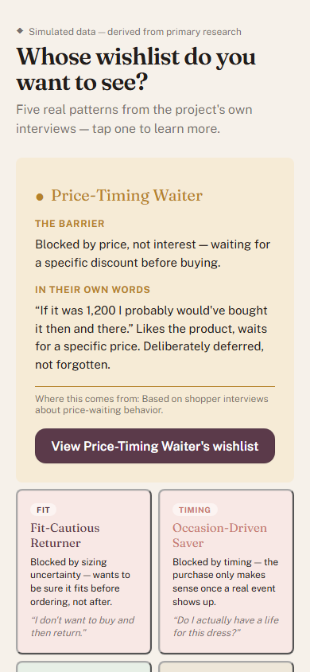
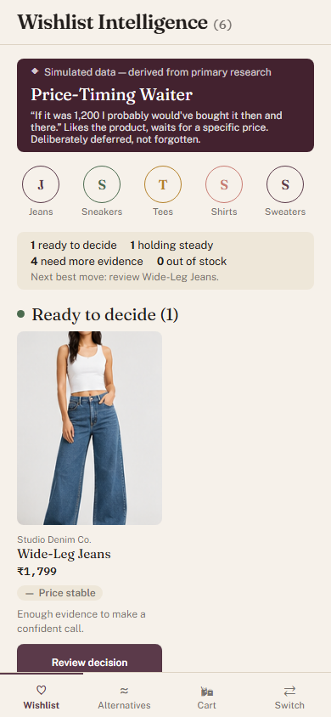
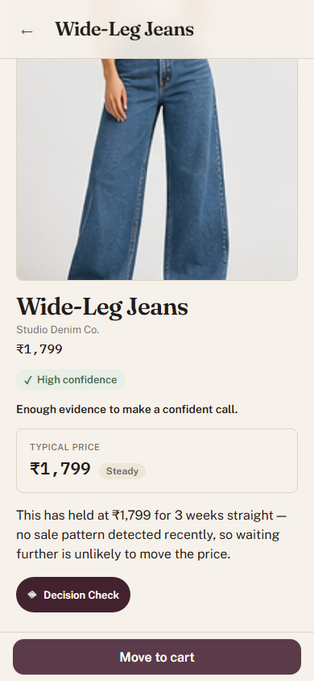
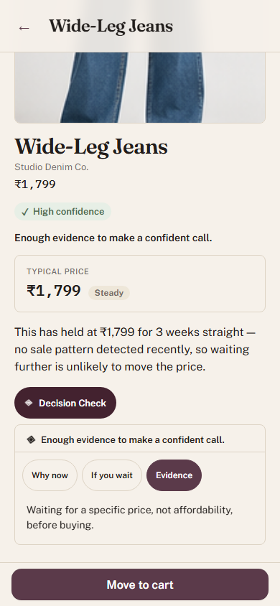
Live MVP walkthrough
LIVE MVP mvp-henna-delta.vercel.app
→
→
→
Persona Picker
Wishlist Intelligence
Item Detail
Decision Check
FLAGSHIP CASE — WIDE-LEG JEANS
“If it was 1,200 I probably would've bought it then and there.” — the real interview quote (slide 4) directly powers this item's price-history box and Decision Check reasoning. Traced end to end from problem definition to pixel, not a plausible-sounding guess.
Also shown live today: real category filter chips, an honest "Holding steady" bucket for settled-but-thin-evidence items, and "Tracking a partial move" for items with a real, quantified price drop that hasn't hit target yet — three separate, verified fixes so the UI never contradicts its own data.
Wishlist → Purchase Conversion | NL Myntra
8

Slide 9
Success means saves that convert, not saves that pile up
NORTH STAR
Wishlist-to-Purchase, Within 30 Days
The business metric this whole project decomposes and targets (slide 1). Unchanged.
MVP LEADING INDICATORS
Trace-widget open rate · Trace-to-cart conversion
Does the reasoning get read — and does resolving uncertainty actually lead to action?
GUARDRAIL
False-urgency rate
“What if I wait” shown where stock/price didn't actually change afterward. Designed in from day one, not added for this slide.
No number is claimed as currently measured that isn't — the MVP is not yet wired to a live event pipeline for these three. They are the defined, agreed targets this project's architecture is built to support, not a retrospective result.
Wishlist → Purchase Conversion | NL Myntra
9

Slide 10
What could go wrong, and what we're doing about it
Local-model consistency is weak
1
No mechanism brings users back
2
If ever wired to live inference, inconsistent classification could show contradictory reasoning to the same user across visits — undermining trust in Decision Check specifically, not just a data-quality footnote.
Slide 1 names Re-encounter as a decomposition factor, but this MVP has zero feature addressing it — no notification, no reminder, nothing that resurfaces a saved item.
MITIGATION: Production path uses the stronger hosted model with retry-escalation; local is a documented fallback only.
MITIGATION: Explicitly out of scope for this MVP — named here as the single most important next-build priority, not hidden.
Honest "nothing changes" could kill urgency
3
Evidence framing could feel like friction
4
The mirror image of the false-urgency guardrail (slide 9): if the tool is too passive, it could resolve uncertainty without ever prompting action at all.
Users who just want a fast decision may experience Decision Check's confidence/evidence framing as an added analysis step, not a shortcut.
MITIGATION: The existing trace-to-cart conversion leading indicator is designed to catch exactly this — high trace-opens with low cart-adds is the signal.
MITIGATION: "Move to cart" stays the primary, always-visible path; Decision Check is opt-in/expandable, never a blocker.
FULL REPO & RESEARCH TRAIL github.com/blazing-llama/NL-Myntra-Graduation-Project
Wishlist → Purchase Conversion | NL Myntra
10

